Slide 1

Divine Familial Terms

Slide 2
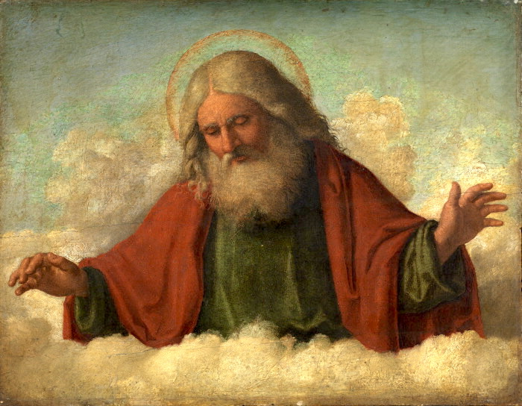

Divine Familial Terms Definition
God is the Father
Jesus is the Son
Father
Trinity
Son
Holy Spirit

Slide 3
?
What are some names or titles the Bible uses for Jesus?
John 1:17
John 1:41
Matthew 9:6
Matthew 14:33

Slide 4
?
What are some names or titles the Bible uses for God?
Matthew 5:16
Genesis 17:1
Genesis 2:4

Slide 5
?
What are some names or titles the Bible uses for the Holy Spirit?
John 14:16
Matthew 3:16
John 16:13

Slide 6
?
Who chose these terms?
Why is it important?

Slide 7

As defined in God’s Word
God is the Father
Jesus is the Son

Slide 8
Some translators have done this differently
God’s chosen one
or
Beloved One
Son of God
Master
or
Most High
God the Father

Slide 9
?
What meaning might be lost if we change these?
Relationship
Significance
Eternal nature
Trinity

Slide 10
1 John 4:14
How God communicated this verse:
The Father has sent the Son to be the Savior of the world.
1
Father
Son
The same verse without Father and Son:
The Master has sent the Beloved One to be the Savior of the world.
2
What is now unclear?
Savior = God
God’s great sacrifice

Slide 11
John 5:17–18
How God communicated these verses (Jesus is speaking):
“My Father is working even now and I, too, am working.” Because of this, the Jews sought even more to kill him because he not only broke the Sabbath, but also called God his own Father, making himself equal with God.
1
“My Father is working even now and I, too, am working.”
His own Father, making himself equal with God.
The same verses without Father:
“My Master is working even now and I, too, am working.” Because of this, the Jews sought even more to kill him because he not only broke the Sabbath, but also called God his own Master, making himself equal with God.
2
What is now unclear?
“Equal with God”

Slide 12

Other Scriptural Examples
John 10:30–31
John 10:33, 36
Hebrews 1:8
John 3:16

Slide 13


